Slide 1

Analysing the Effectiveness of Government Spending on Health across Countries A Project for the Course Programming Techniques
Presented by Daniele Veggiato, Ifeanyi Omokwe, Laura Salomon & Sheharyar Sirhindi (group 6)

Slide 2
Outline
1. Introduction
2. Literature Review
3. Empirical Work
3.1. Data Context
3.2. Data Collection
3.3. Data Preparation
3.4. Data Modelling
3.4.1 Regression Analysis
3.4.2 Cluster Analysis
3.4.3 Geographical Plots
4. Conclusion
References
Questions

Slide 3
Introduction
“Public expenditure ratios have steadily increased in the euro area since the 1960s before peaking and, in some cases, declining in more recent years. Public expenditure is nevertheless much higher than in most other industrialised countries. According to many observers, it exceeds the levels required for the efficient provision of essential public services.”
(ECB, Monthly Bulletin, April 2006, p.73).

Slide 4
Introduction
“The question we ask today is not whether our government is too big or too small, but whether it works (…). Where the answer is yes, we intend to move forward. Where the answer is no, programs will end. And those of us who manage the public's dollars will be held to account – to spend wisely, reform bad habits, and do our business in the light of day – because only then can we restore the vital trust between a people and their government.”
(Barack Obama inaugural speech, 20 January 2009).

Slide 5
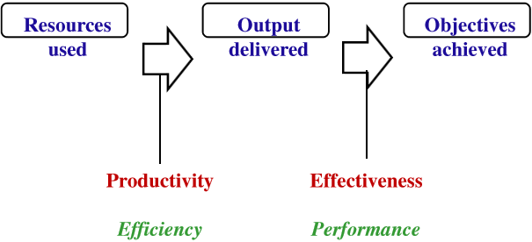
Introduction
Research Question:
Investigate government expenditure on health to understand how resources are indeed efficiently and effectively utilized.

Slide 6
Literature Review
Evans et al. (2000): frontier analysis to rank WHO countries.
Afonso and St. Aubyn (2011): two-steps procedure (DEA/Tobit and bootstrap). Results:
on average, in the OECD 40% inefficiency of public health spending;
other relevant factors: income, education, obesity and smoking.
Crémieux, Ouellette and Pilon (1999). GLS regression with fixed effects on Canadian provinces. Health care spending significantly:
increases life expectancy;
decreases infant mortality.

Slide 7
Empirical Work
Data Context:
Basis: Research Paper by Crémieux, Ouellette and Pilon (1999)
Focus of Search:
Data regarding Life Expectancy and Infant Mortality to serve as proxies for health outcomes
Data regarding Healthcare Expenditure
Data regarding Economic, Socio-Demographic, Nutritional and Lifestyle factors that influence health.

Slide 8
Empirical Work
Data Collection:
Source: World Bank
Sample: 217 countries
Type of Data: Initially data collected in the form of panel data for the period between 2010 - 2018

Slide 9
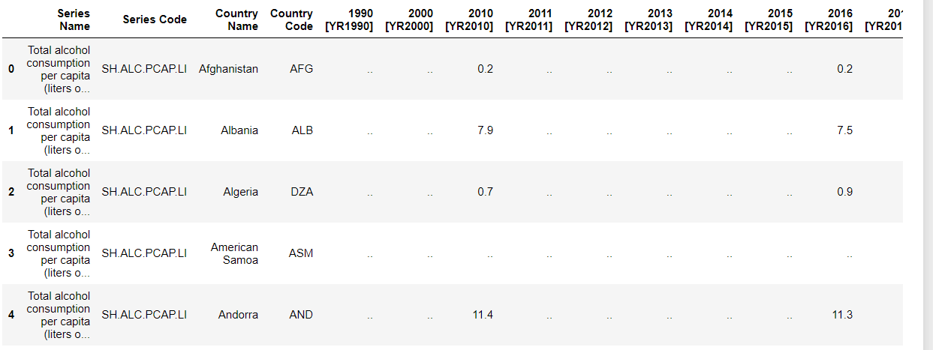
Empirical Work: Data Preparation
Raw data of for the following 9 variables available initially:
Life Expectancy (at birth in years)
Infant Mortality (per 1000 live births)
GDP per Capita (current US$)
Health Exp (% total govt. exp)
Alcohol (Cons/capita age 15+)
Education (post-secondary % total pop. age 25+)
Physicians (per 1000 people)
Smoking (% total pop. age 15+)
Poverty (gap $3.2 per day in %)
Initial outlook of data for each variable:

Slide 10
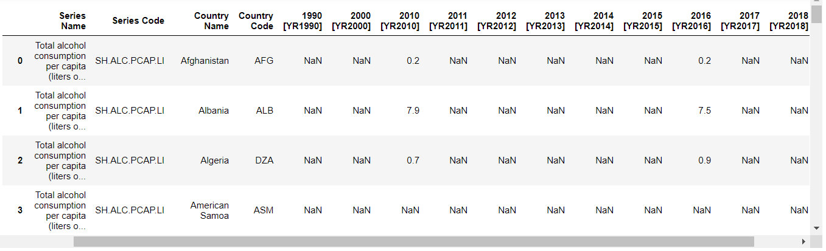
Empirical Work: Data Preparation
Replacing ‘..’ with NaN:

Slide 11
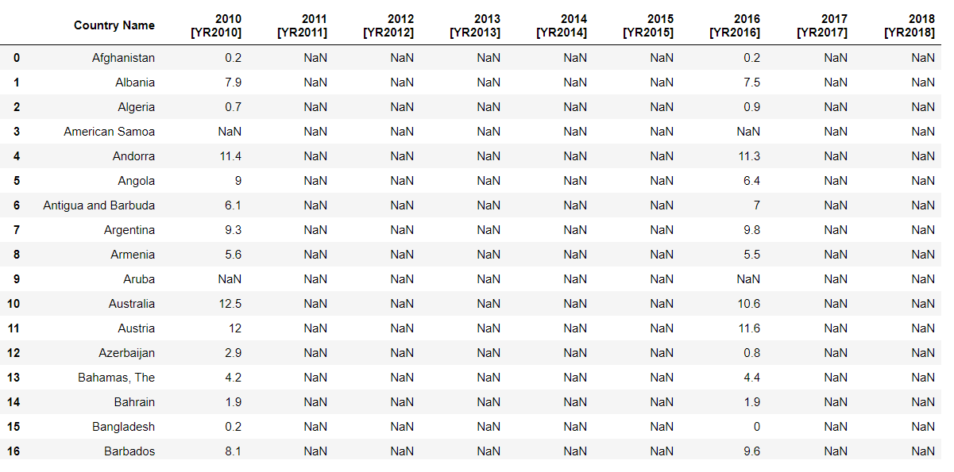
Empirical Work: Data Preparation
Selecting only required data columns:

Slide 12
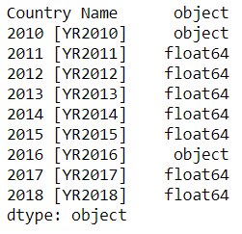
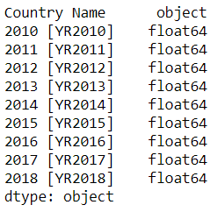
Empirical Work: Data Preparation
Converting data to numeric:

Slide 13
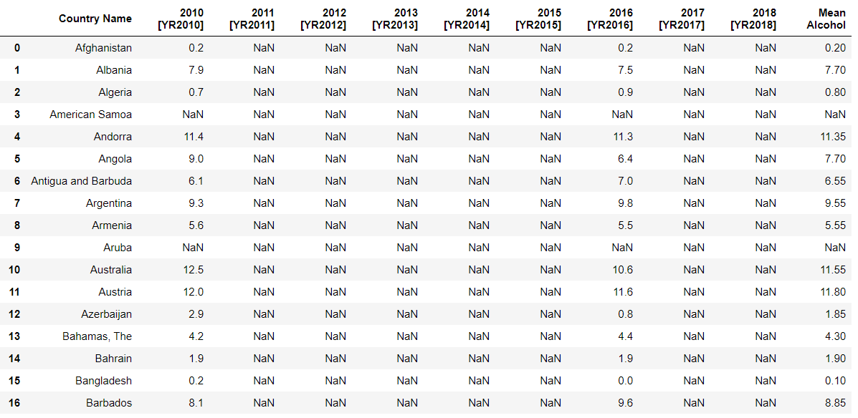
Empirical Work: Data Preparation
Taking mean of all years in a separate column to get cross-sectional data for one time-period (2010-2018):

Slide 14
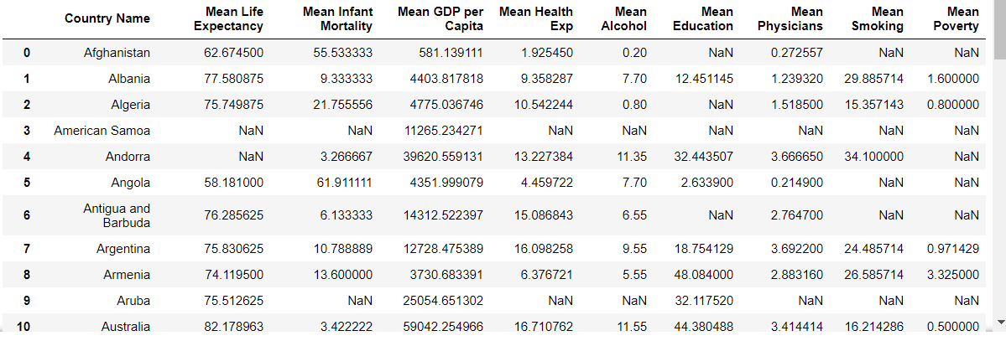
Empirical Work: Data Preparation
Creating a list of all dataframes with mean columns and merging all dataframes:

Slide 15
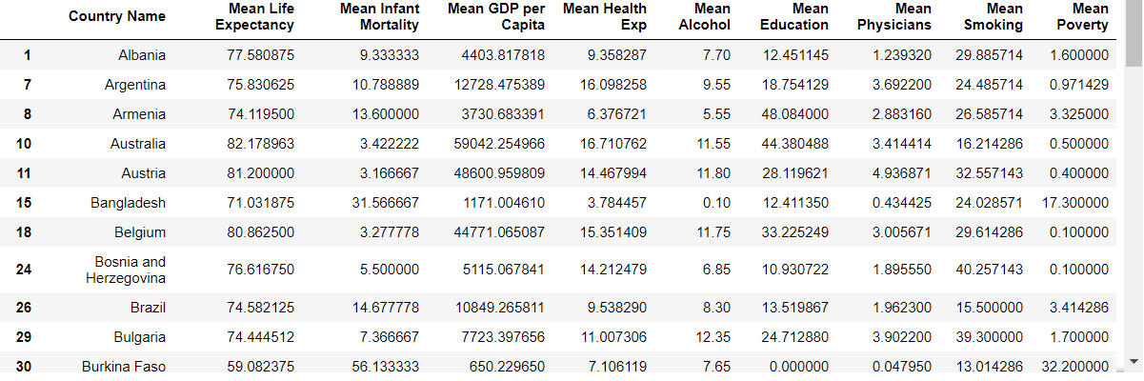
Empirical Work: Data Preparation
Dropping missing values (NaN), leaving us with a sample of 85 countries:

Slide 16
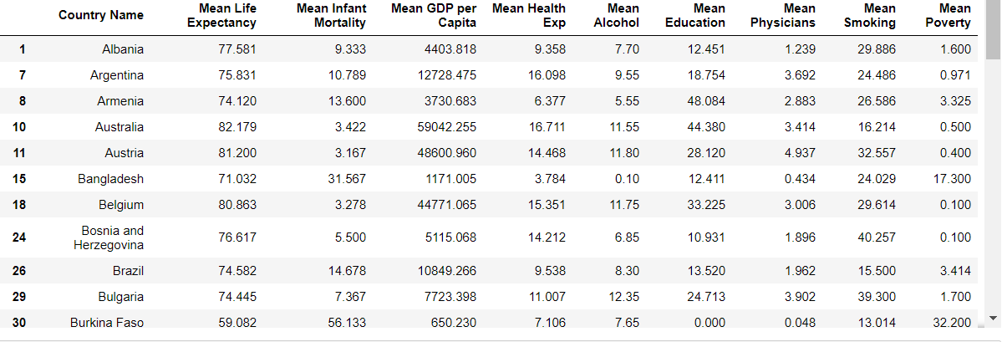
Empirical Work: Data Preparation
Rounding values to 3 decimal places to get final data:

Slide 17
Empirical Work
Data Modelling
Regression Analysis
Cluster Analysis
Geographical Plots

Slide 18
Empirical Work: Data Modelling
Regression Analysis:
Dependent Variables:
Life Expectancy
Infant Mortality
Independent Variables:
Total health expenditure
GDP per Capita
Education
Physicians
Smoking
Poverty
Alcohol
Model 1:
Life Expectancy = β₀ + β₁Health Expenditure + β₂GDP per capita + β₃Education + β₄Number of Physicians + β₅Poverty + β₆Alcohol Consumption + β₇Smoking + μ
Model 2:
Infant Mortality = β₀ + β₁Health Expenditure + β₂GDP per capita + β₃Education + β₄Number of Physicians + β₅Poverty + β₆Alcohol Consumption + β₇Smoking + μ

Slide 19
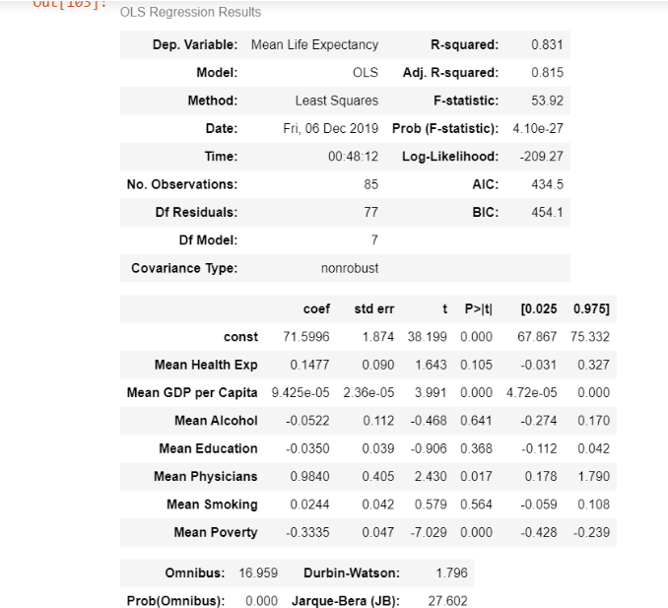
Data Modelling: Regression Analysis
Regression of Life Expectancy against all independent variables
Some important results:
R² = 83.1%
Health Exp. → Statistically significant at around 10% of significance
Health Exp. Increases → Life Expectancy increases
Other significant results: Number of physicians has a positive relationship while poverty has a negative relationship

Slide 20
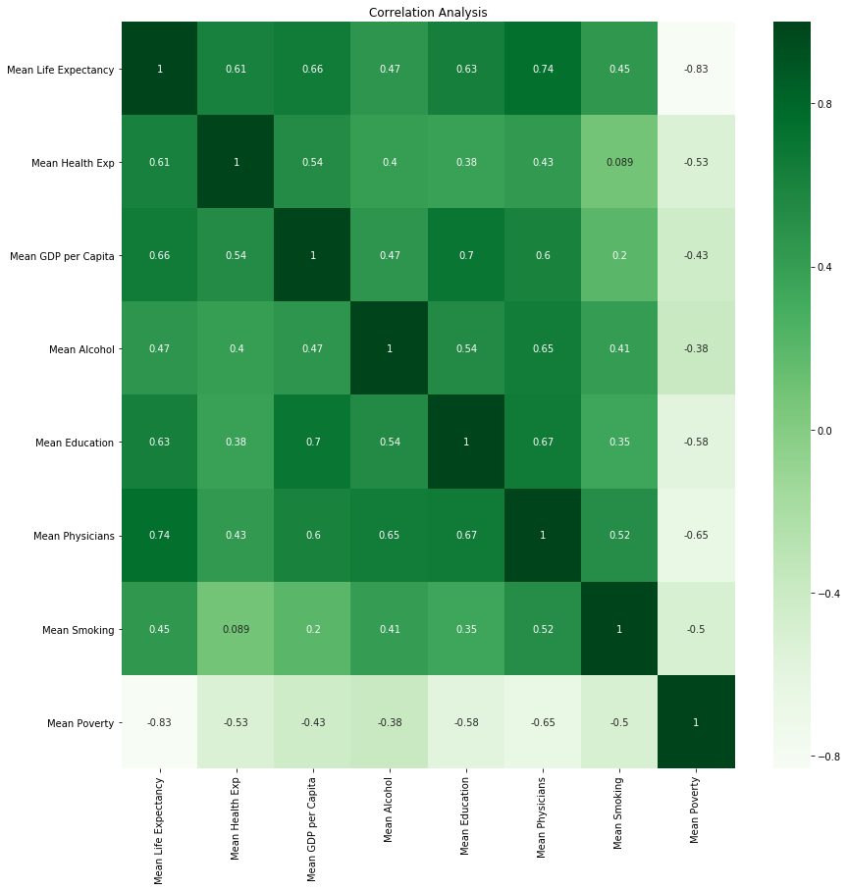
Data Modelling: Regression Analysis
Correlation Analysis:
Some important results:
Health Exp. is positively correlated with Life Expectancy
Number of Physicians is positively correlated with Life Expectancy
Poverty is negatively correlated with Life Expectancy
Among independent variables correlation not that high; only education and GDP per capita are slightly correlated (but it does not affect the results)

Slide 21
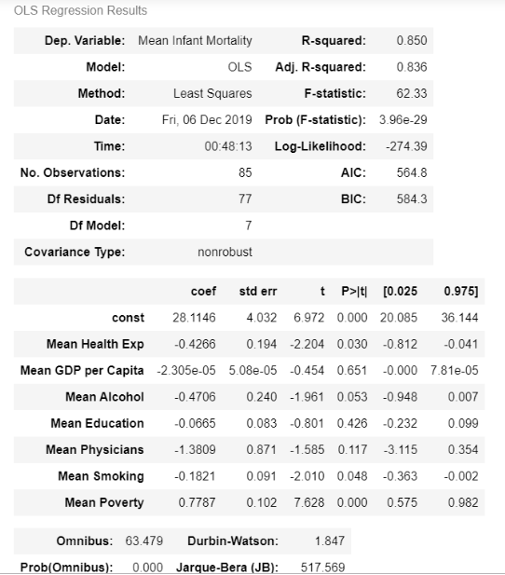
Data Modelling: Regression Analysis
Regression of Infant Mortality against all independent variables
Some important results:
R² = 85.0%
Health Exp. → Statistically significant
Health Exp. Increases → Infant Mortality decreases
Other significant results: Number of physicians has a negative relationship while poverty has a positive relationship

Slide 22
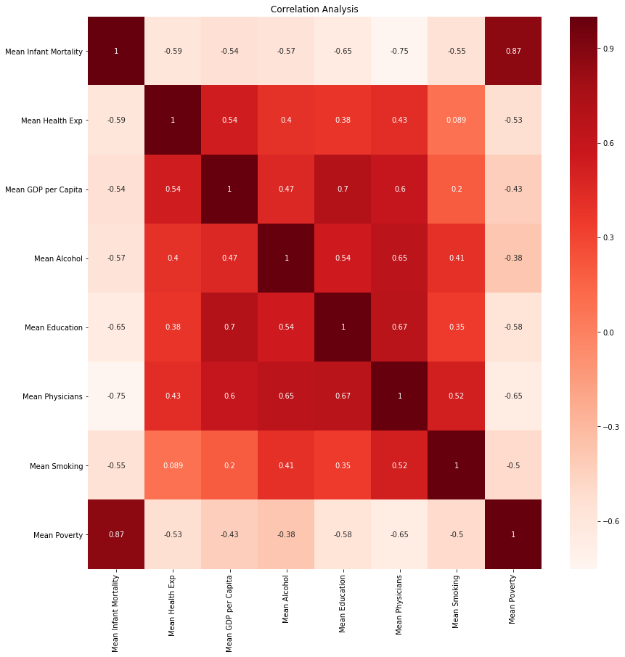
Data Modelling: Regression Analysis
Correlation Analysis:
Some important results:
Health Exp. is negatively correlated with Infant Mortality
Number of Physicians is negatively correlated with Infant Mortality
Poverty is positively correlated with Infant Mortality
Among independent variables correlation not that high; only education and GDP per capita are slightly correlated (but it does not affect the results)

Slide 23

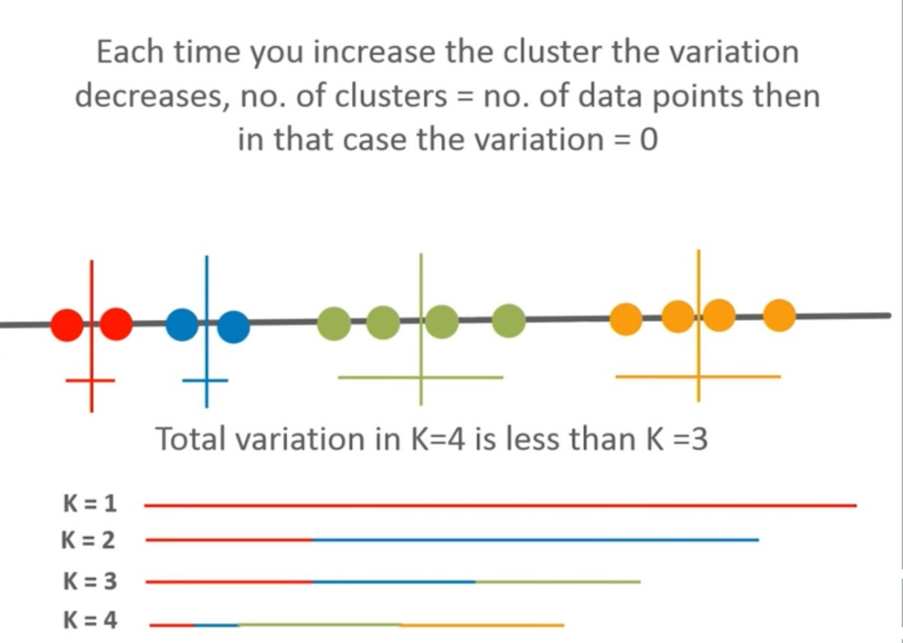
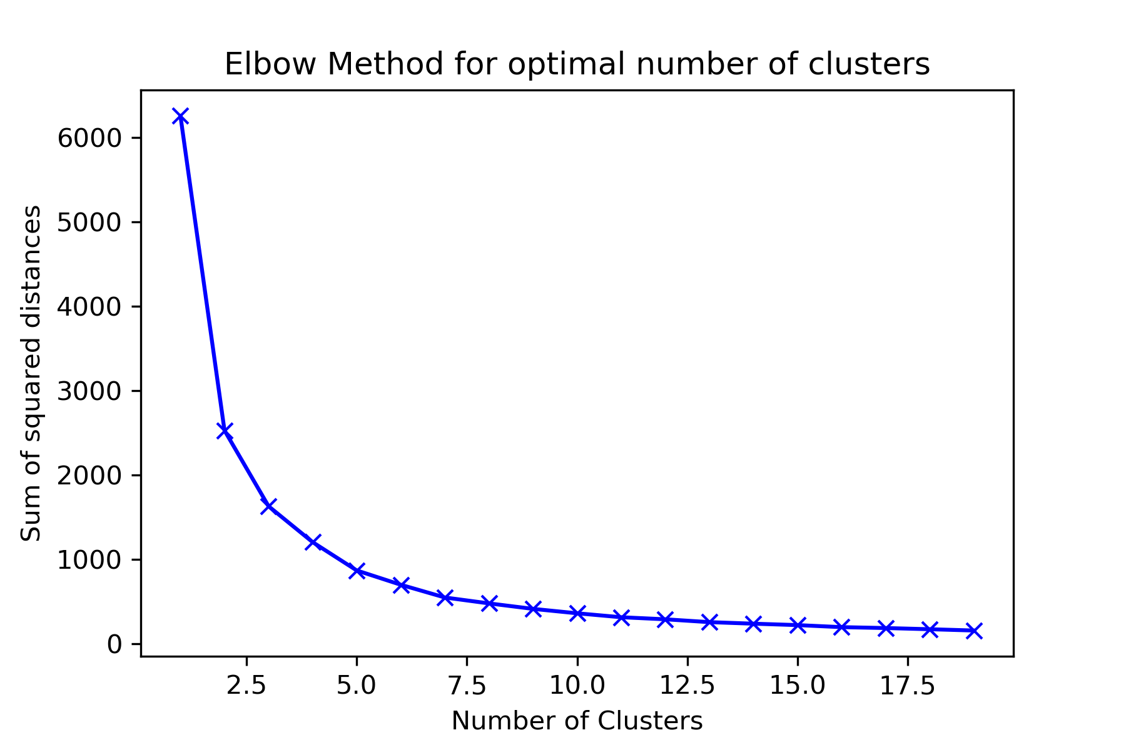
Cluster Analysis: Divisive Clustering with K-Means
Source: https://www.youtube.com/watch?v=1XqG0kaJVHY

Slide 24
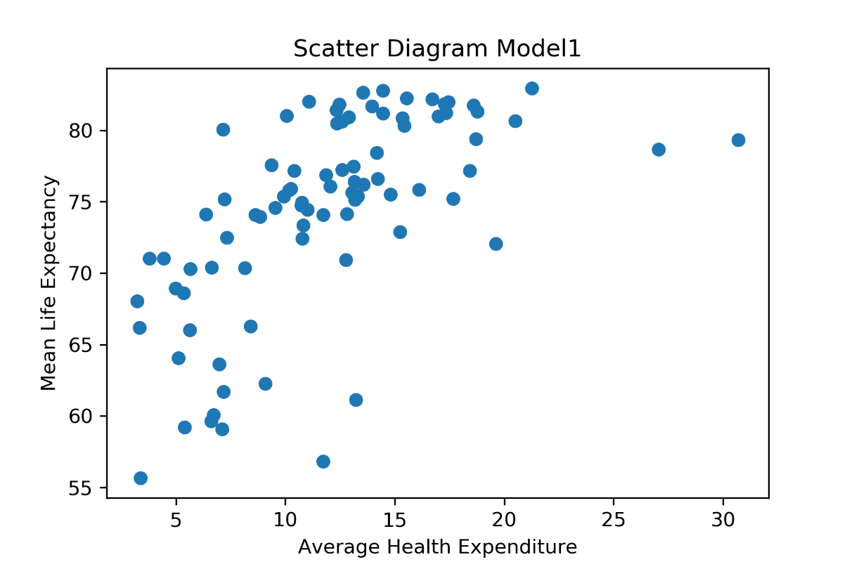
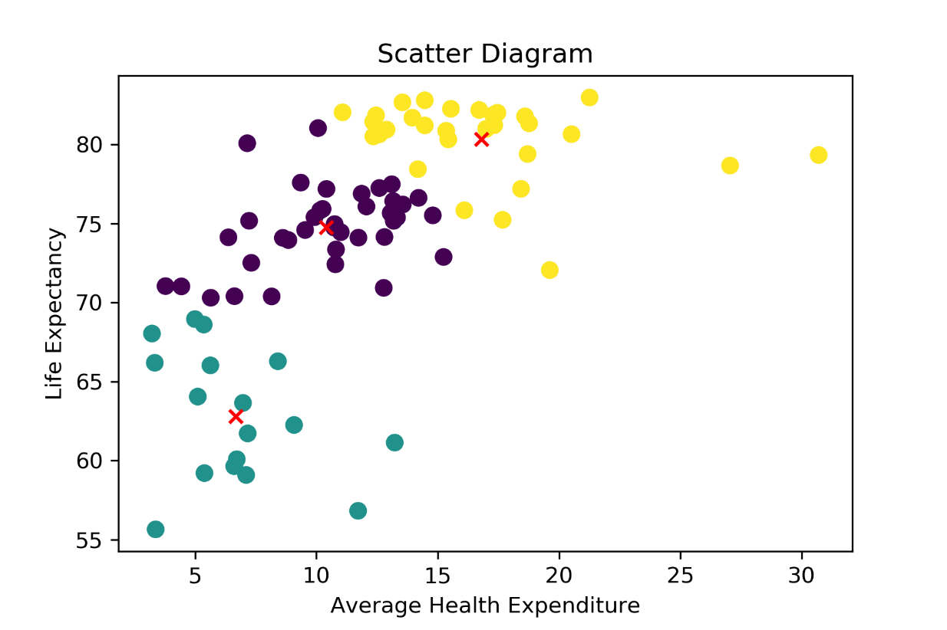
Cluster Analysis: Divisive Clustering with K-Means – Model 1

Slide 25
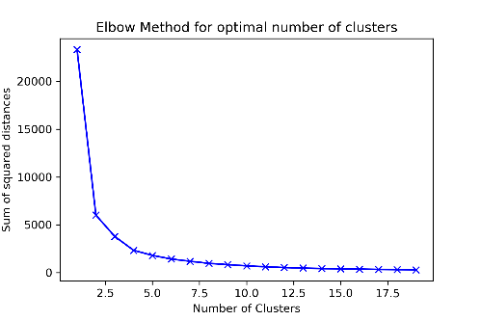
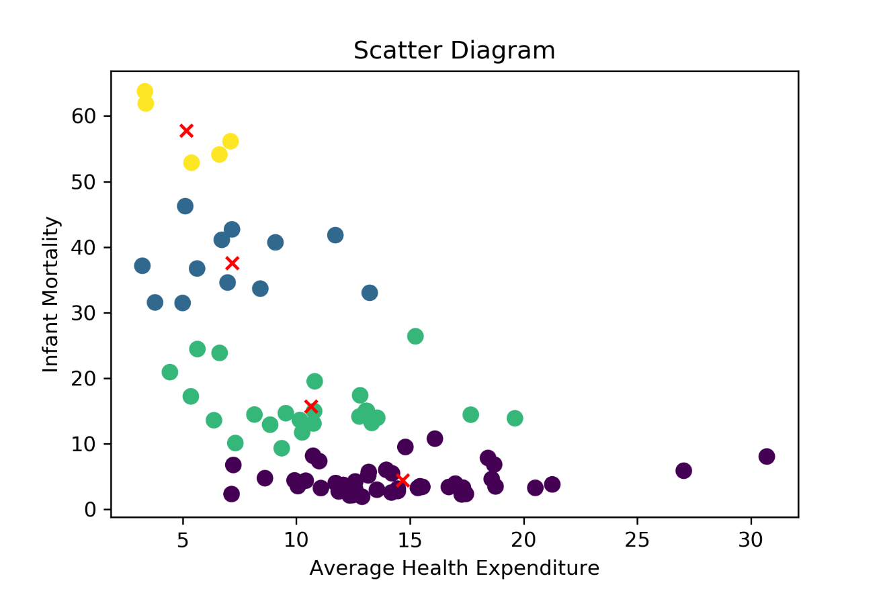
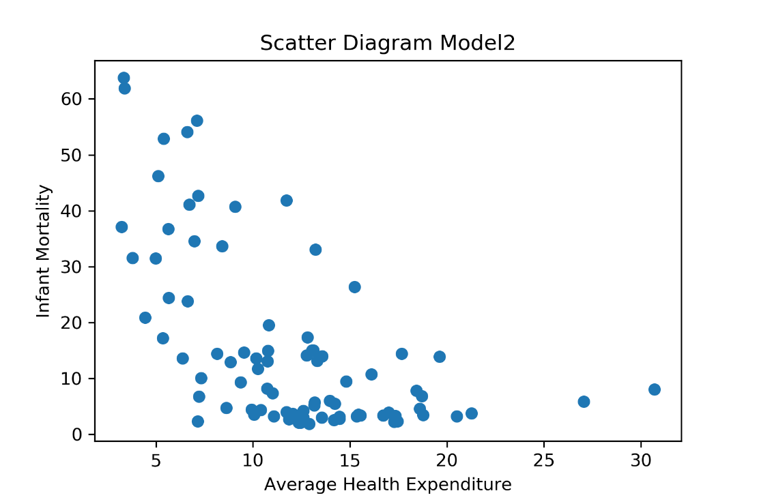
Cluster Analysis: Divisive Clustering with K-Means - Model 2

Slide 26
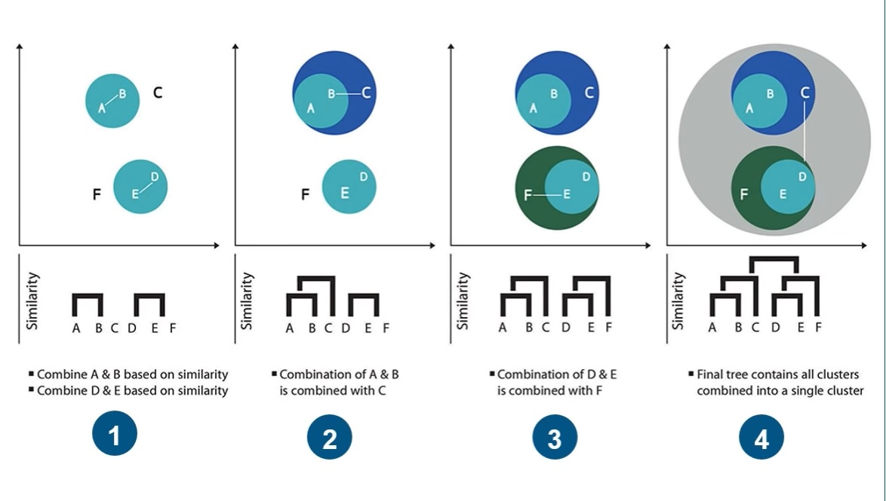
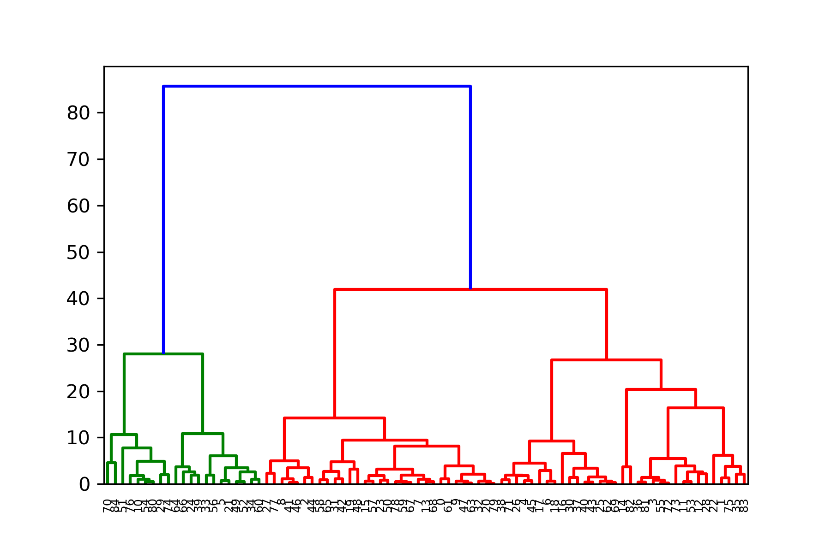
Cluster Analysis: Hierarchical Clustering with Dendrograms
Source: https://www.youtube.com/watch?v=1XqG0kaJVHY

Slide 27
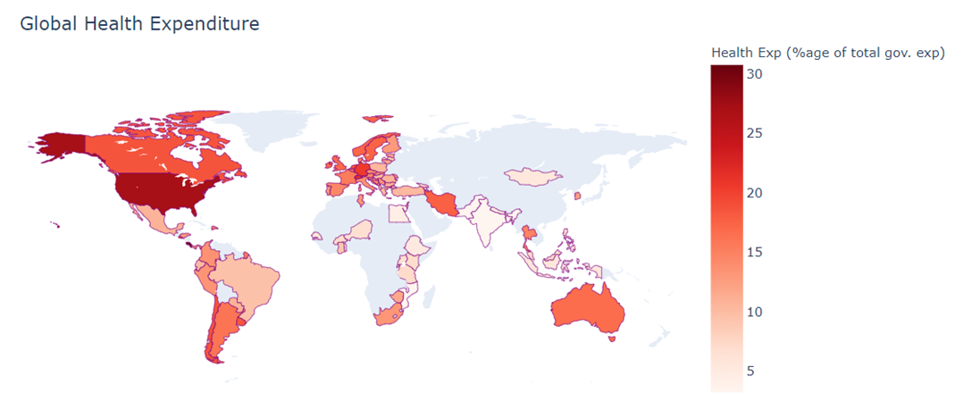
Data Modelling: Geographical Plots
Geographical Plotting with library Plotly - World Choropleth Map:

Slide 28
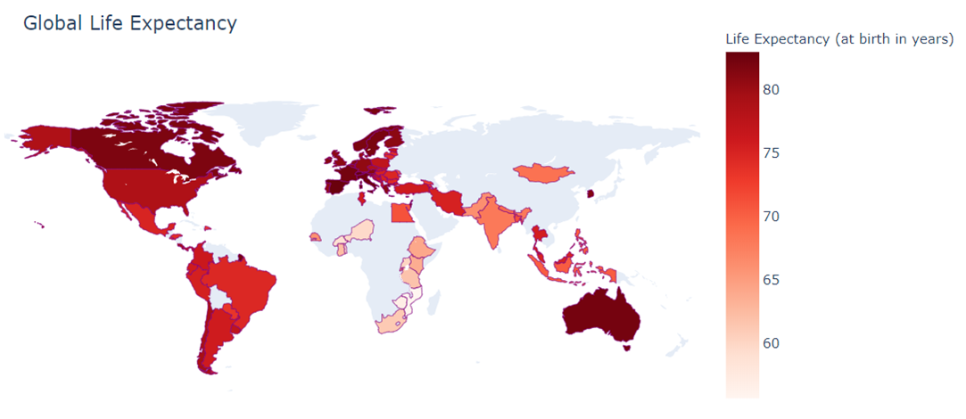
Geographical Plots

Slide 29
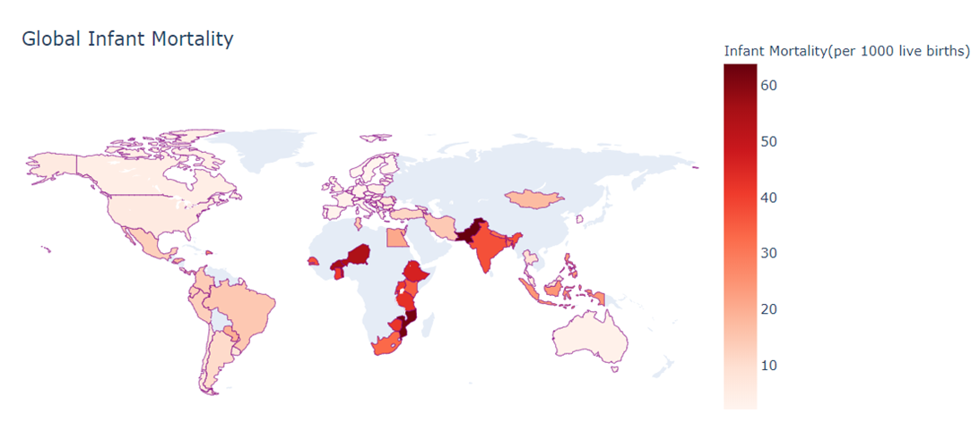
Geographical Plots

Slide 30
Conclusion
Government expenditure on health is effective in improving the health outcomes across countries
This is shown by the results of the two regressions whereby, health expenditure is shown to be positively correlated with life expectancy and negatively correlated to infant mortality for our sample of countries
The scatter plots also provide evidence to the above relationships
A comparison of the geographic plots also shows that areas spending more on health have better life expectancy and lower infant mortality rates

Slide 31
References
Afonso, A., & St. Aubyn, M. (2011). Assessing health efficiency across countries with a two-step and bootstrap analysis. Applied Economics Letters, 18(15), 1427-1430.
Crémieux, P. Y., Ouellette, P., & Pilon, C. (1999). Health care spending as determinants of health outcomes. Health economics, 8(7), 627-639.
Evans, D. B., Tandon, A., Murray, C. J., & Lauer, J. A. (2000). The comparative efficiency of national health systems in producing health: an analysis of 191 countries. World Health Organization, 29(29), 1-36.

Slide 32




